Slide 1
Intake & Output
PNU145 Fundamentals
Cheryl Proffitt RN,MSN

Slide 2
Intake and Output

Slide 3
What is Intake and Output
Input and output is calculated for a variety of patients in different settings from Intensive Care Units (ICU) to home
Other cases includes clients with: foley Catheter, fluid restrictions,stage 3-4 pressure Ulcers

Slide 4
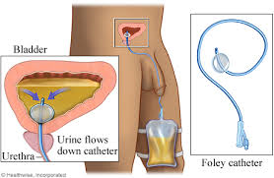
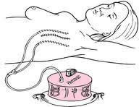
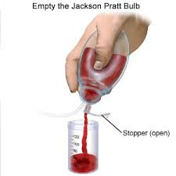
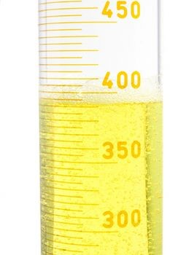
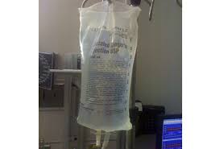
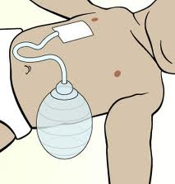
Examples

Slide 5
Intake and Output
The process involves recording all the fluid that goes into the patient and the fluid that leaves the body.
Remember in normal conditions the intake should equal output in 24 hours.

Slide 6
Intake
Items to Calculate
Liquids taken PO such as water, juice, milk, etc
Intravenous fluids (IV) such as D5W, D5RL
Feedings via nasograstic or PEG tubes

Slide 7
Output
Items to Calculate
Urine or liquid feces
Blood excessive bleeding
Drainage from wounds or suction

Slide 8
Intake and Output
When calculating intake and output, consider all fluids in and out of the body.
Having a sheet of paper at the bedside to record intake of fluids is desirable.
At the end of the shift, the paper is collected and a new sheet provided.
All intake AND OUTPUT ARE RECORDED at the end of the shift

Slide 9
Intake and output
Senerio
Calculation
A patient has recorded the following on a sheet of paper at the bedside:
Breakfast: eggs, toast, 6 oz of coffee ; small orange juice (4 ounces)
Lunch: sandwich, apple, 8 oz of tea
Dinner: chicken, broccoli, rice, 2 glasses of tea
Between meals: 8 oz of water
1000 mL of D5 W infusing IV at 30 mL/hour
Calculate the Intake for a 12 hour shift: Note you need to covert ounces to mLs
Item mLs
Coffee 6 oz x 30 =180 mL
OJ 4 oz x30 =120 mL
Tea 8 X 30 oz=240 mL
Water 8 x30 oz =240 mL
IV 30mL x 12 360 mL
Total Intake for 12 hrs
PO= 780mL
IV infusion= 360mL

Slide 10
Intake and Output
Senerio
Calculation
The patient recorded the following amounts voided on the sheet of paper: 400 cc at 7:00 am; 100cc at 10:00 am; 200cc at 12 noon; 150 cc at 2:00 pm; 400cc at 6:00 pm. The nurse emptied 300cc from a JP tube. The patient vomited 100cc at 4:00 pm What is the total output for the 12 hour shift?
Item
mLs
Urine 1250
Drainage 300
Vomited 100
Total Output
1650 mLs

Slide 11
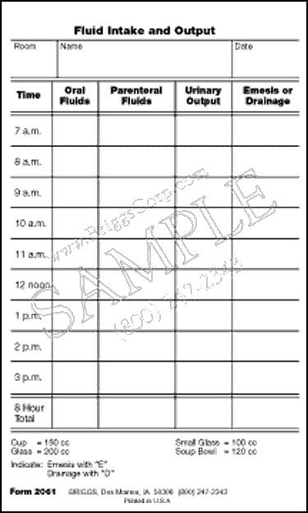

Slide 12
Some Important Info
Clinical Do's and Dont's
DO- Identify whether your patient has undergone surgery or if he has a medical condition or takes medication that can affect fluid intake or loss.
Measure and record all intake and output. If you delegate this task, make sure you know the totals and the fluid sources.
At least every 8 hours, record the type and amount of all fluids he's received and describe the route as oral, parenteral, rectal, or by enteric tube.

Slide 13
Some Important Info
Record ice chips as fluid at approximately half their volume.
Record the type and amount of all fluids the patient has lost and the route.
Describe them as urine, liquid stool, vomitus, tube drainage and any fluid aspirated from a body cavity.
If irrigating a nasogastric or another tube or the bladder, measure the amount instilled and subtract it from total output.

Slide 14
Some Important Info
DO- For an accurate measurement, keep toilet paper out of your patient's urine.
Measure drainage in a calibrated container.
Observe it at eye level.
Evaluate patterns and values outside the normal range, keeping in mind the typical 24 – hour intake and output.

Slide 15
Some Important Info
DO- When looking at 8 – hour urine output, ask how many times the patient voided, to identify problems.
Regard intake and output holistically because age, diagnosis, medical problem, and type of surgical procedure can affect the amounts.
Evaluate trends over 24 to 48 hours.

Slide 16
Some Important Info
DON’TSDon't delegate the task of recording intake and output until you're sure the person who's going to do it understands its importance. Don't assess output by amount only. Consider color, color changes, and odor too. Don't use the same graduated container for more than one patient.

Slide 17
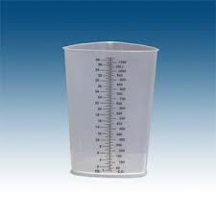
Some Important Info

Slide 18
References
WWW.Google.com. Intake and output. Retrieved ,Oct.10th,2013.

