Slide 1
The Nursing Process
Fundamentals of Nursing
PNU-145
Cheryl Proffitt, RN,MSN
September, 2015

Slide 2
Learning Objectives
Define the term Nursing Process
Describe seven characteristics of the nursing process
List five steps in the nursing process
Identify four sources of assessment data
Differentiate between data base, focus, and functional assessment
Distinguish between a nursing diagnosis and a collaborative problem

Slide 3
Learning Objectives Cont’d
List three parts of a nursing diagnostic statement
Describe the rationale for setting priorities
Discuss appropriate circumstances for short term and long term goals.
Identify four ways to document a plan of care
Describe the information that is documented in a plan of care
Discuss three outcomes that results from an evaluation
Describe the process of concept mapping as an alternative learning strategy for student clinical experiences.

Slide 4
Introduction
In the past nursing practice was based on common sense, and experiences from older nurses. ( for example Florence Nightingale).
Today nurses are held responsible for safe and effective care that reflects the standard for nursing practice.

Slide 5
What is the Nursing Process
It is an organized sequence of problem solving steps
It is a process used to identify and manage the health problems of clients
It is the acceptable standards for clinical practice established by the American Nurses Association (ANA).
It is a framework for nursing care
It allows clients to receive quality care with maximum efficiency

Slide 6
Characteristics of the Nursing Process
The Nursing Process has seven distinct Characteristics
Within the legal scope of nursing
Based on knowledge
Planned
Client centered
Goal directed
Prioritized
Dynamic

Slide 7
Characteristics of the Nursing Process – Explanation of Each- Cont’d
Within the legal scope of nursing- means practicing nursing independently to problem-solve, involving diagnosing and treatment of potential health problems.
Based on knowledge- means using critical thinking skills to identify and resolve problems, by using evidence based nursing interventions.
Planned- this leads to organized, orderly and systematic care

Slide 8
Characteristics of the Nursing Process- Explanation cont’d
Client-centered- the process helps nurses to plan care centered on that particular patient, allowing them to actively participate in their care.
Goal directed- The nurse is able to work with the client and develop goals and outcomes.
Prioritized-Focusing on more serious health /risk factors for a resolution
Dynamic- Constant changes in health status requires evaluations, data collection and revaluation

Slide 9
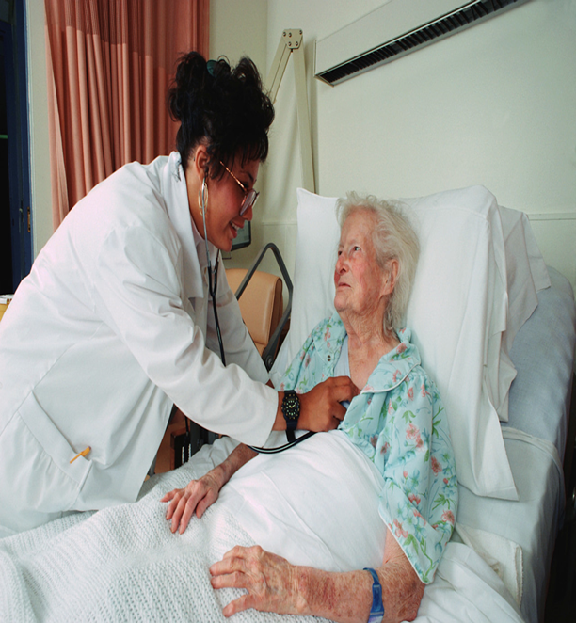
Steps in the Nursing Process
There are five Steps in the Nursing Process
Assessment
Diagnosis
Planning
Implementation
Evaluation

Slide 10
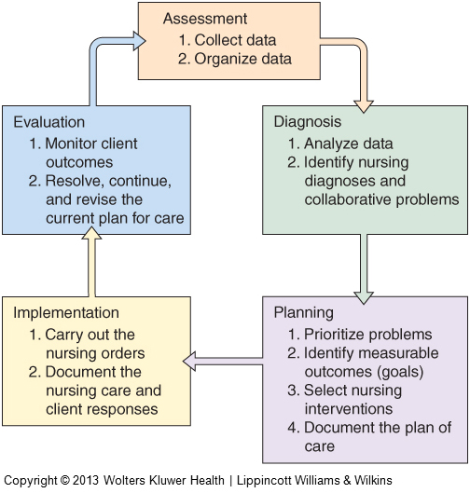
Steps of the Nursing Process
  Assessment is the First step in the nursing process, involving nurse/client contact
  It involves collection of data from the client, such as abnormal findings, things that causes health problems.
  Types of Data
  Data can be Objective , or signs of a disorder which are observable or measurable.
  OR it can be
  Subjective or symptoms that the client feels and can describe .

Slide 11
Steps of the Nursing Process
Examples of Objective Data (see)
Weight
Temperature
Skin color
Blood cell count
Vomiting
Bleeding
Examples of Subjective Data (what the client feels)
Pain
Nausea
Depression
Fatigue
Anxiety
Loneliness

Slide 12
Steps of the Nursing Process (cont’d)
  Sources of data:
  Primary source– The client
  Secondary sources– The client’s family, reports, test results past medical history or discussion with other health care professionals
  Types of assessment
  1. Data Base Assessment
  2. Focus Assessment
  3. Functional Assessment

Slide 13
Comparison of Assessments
Database Assessment
Is obtained on admission
Consists of predetermined questions and systematic head-to toe examination
Performed once
Suggests possible problems
Findings documented on an admission assessment form
Time-consuming -1hr or more
Supplies a broad, volume of data
Provides breadth for future comparisons
Reflects the clients condition on entering the health care system

Slide 14
Comparison of Assessments Cont’d
Focus Assessment (provides more details)
Compiled throughout subsequent care
Consists of unstructured questions and a collection of physical assessments
Repeated each shift or more often
Rules out or confirms problems
Findings are documented on checklist or progress notes
Completed about 15 mins.
Collects limited data
Adds depth to the initial database
Provides comparative trends for evaluating the clients response to treatment.

Slide 15
Comparison of Assessments Cont’d
Functional Assessment ( PROMOTED BY JCHCO)
Completed within the first 14 days of admission
Can follow various assessment tools e.g. Minimum Data Set (MDS). MDS is repeated at least every 12 months or immediately after a significant change in physical or mental status; ( MDS) is reviewed every 3 months, and identifies physical , psychological, and social factors that affect self care of the patient. ( Called Quarterly assessment)
Findings documented on tools such as the MDS
May involve a multidisciplinary team with final completion and signed by an RN.
Comprehensive evaluation for strength or decline are done and the data is compared /used as facility quality report. (box2-3)

Slide 16
Info on Medicare &Insurance
Medicare
Medicaid
Medicare is generally for people who are older or disabled.
A federal health insurance program for people who are:
65 or older, Under 65 with certain disabilities or of any age and have End-Stage Renal Disease (ESRD
Governed /Federal government
Covers: Care and services / inpatient in a hospital or skilled nursing facility (Part A),Doctor visits, services received as an outpatient, and some preventive care (Part B).
Costs: Depends on the coverage you choose.
Medicaid is for people with limited income and resources.
A joint federal and state program that helps pay health care costs for certain people and families with limited income and resources.
Governed/ State governments
Covers : Care and services received in a hospital or skilled nursing facility, a federally qualified health center, rural health clinic or freestanding birth center (licensed or recognized by your state),Doctor, nurse midwife and certified pediatric and family nurse practitioner services
Costs: Depends on your income and the rules in your state.

Slide 17
Assessments Cont’d

Slide 18
Assessment Cont’d
So we have completed the Assessments, what do we do with the data?
Organization of Data
Done by grouping related information and by organizing data into small groups

Slide 19
Steps of the Nursing Process
The next step is Diagnosis
This is the second step in the nursing process
The nurse identifies health related problems, analyzing data for abnormal findings that results in a diagnosis.
Nursing Diagnosis : Is a health issue that can be prevented reduced, or enhanced through independent nursing measures
There are five categories of nursing diagnosis
See table 3-2

Slide 20
Steps of the Nursing Process
Nursing Diagnosis Cont’d--Five Groups Are :
Actual Diagnosis:- e.g. a problem that currently exists. (table 2-2 for example)
Risk Diagnosis:- A problem the client is uniquely at risk for developing ( Tb 2-2 )
Possible Diagnosis:- a problem may be present, but requires more data collection to r/o or confirm its existence. ( 2-2)
Syndrome Diagnosis:- Cluster of problems predicted to be present because of an event or situation (2-2)
Wellness Diagnosis:- a health-related problem that requires assistance to perform at a higher level.(2-2)

Slide 21
Diagnosis-The NANDA List
NANDA- Refers to North American Nursing Diagnosis Association. (Found at the back of the text book).
It was designated by ANA ( American Nursing Association) as the organization to develop and approve nursing diagnosis.
NANDA revises diagnosis every 2 years and publishes findings.
If problems does not fit NANDA diagnosis, the nurse can use their own terminology for nursing diagnosis.

Slide 22
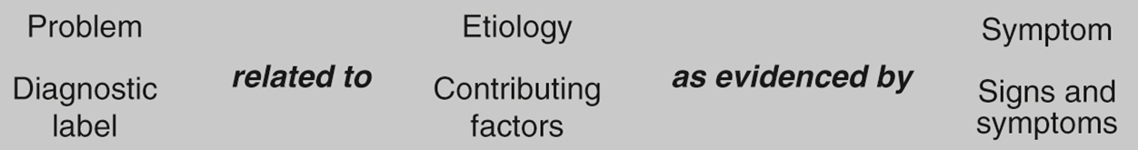
Parts of a Nursing Diagnostic Statement
The Nursing Diagnostic statement has 3 parts
1. The problem or health-related issue:- (NANDA)The client has a disturbed sleep pattern
2. Etiology or cause:- The disturbed sleep is related to excessive intake of coffee
3. Signs and Symptoms:- As manifested by difficulty in falling asleep.
Feels tired during the day
Irritability during the day with others.

Slide 23
Diagnosis Cont’d
Collaborative Problems:- Requires both nurse and physician interventions ( to collaborate)
Accountability of the nurse includes:-
1. To correlate medical diagnosis/treatment/ risk for complications
2.Documenting risk complications
3. Making assessments to detect complications
4. Reporting developing signs of complications
5. Managing problems arising with with nurse/physician measures.
6. Evaluating the outcomes.

Slide 24
Collaborative Problems Cont’d
How do identify a Collaborative Problems ?
look on the plan of care sometimes abbreviated PC
( potential complication)
Pages 22 in your text has examples of Collaborative Problems

Slide 25
Steps in the Nursing Process- Planning
Planning:- The third step in the nursing process.
It is the process of prioritizing nursing diagnosis and collaborative problems
It identifies measurable goals and outcomes
Helps to selects appropriate interventions
Helps to document the plan of care.

Slide 26
Steps in planning
Setting Priorities
Establishing Goals
Selecting Nursing interventions
Documenting the Plan of Care

Slide 27
Steps in the Nursing Process- Planning
To plan there are priorities that have to be set.
First we have to determine which problems require immediate or less attention. ( in other words the most serious).
Ways to determine priorities of needs (Table 2-4). These priorities can change as new problems arise or are resolved.
A method used is Maslow’s Hierarchy of human needs (chap.4)

Slide 28
Steps in the Nursing Process- Planning. Prioritizing Nursing Diagnosis
Human needs
Physiological
Examples of Nursing Diagnoses
Imbalanced nutrition: less than body requirements.
Ineffective breathing Pattern
Pain
Impaired Swallowing
Urinary retention

Slide 29
Steps in the Nursing Process- Planning. Prioritizing Nursing Diagnosis
Human needs
Safety and security
Examples of Nursing Diagnoses
risk for injury
Impaired verbal communication
Disturbed thought processes
Anxiety
Fear

Slide 30
Steps in the Nursing Process- Planning. Prioritizing Nursing Diagnosis
Human Need
Love and belonging
Examples of nursing Diagnoses
Social isolation
Impaired social interactions
Interrupted family processes
Parental role conflict

Slide 31
Steps in the Nursing Process- Planning. Prioritizing Nursing Diagnosis
Human Need
Esteem and self- Esteem
Examples of Nursing Diagnoses
Disturbed body image
Powerlessness
Caregiver role strain
Ineffective breast feeding

Slide 32
Steps in the Nursing Process- Planning. Prioritizing Nursing Diagnosis
Human Need
Self-actualization
Examples of Nursing Diagnosis
Delayed growth and development
Spiritual development

Slide 33
Steps in the Nursing Process- Planning.
Establishing Goals-----What are goals?
Goals are expected or desired outcomes. Goals help the nurse to determine if the nursing care done is appropriate for the nursing diagnosis.
They can be short-term or long term
An example of a goal-
Goal- The client will be well hydrated by 10/23
An example of an outcome ( more specific)
The client will have adequate hydration as evidenced by an oral intake 2-3,000 mls/24 hrs by8/23

Slide 34
Steps in the Nursing Process- Planning
Short-Term Goals are used mostly by nurses in an acute care setting,(few days- 1 week) and have the following characteristics: (box 2-7 example)
1. Are developed from the problem portion of the diagnostic statement
2. Are client centered/ what they can accomplish
3. Measurable, identifies evidence of goals achieved
4.Realistic, avoid attainable goals
5. Accompanied by a target date for accomplishment.

Slide 35
Steps in the Nursing Process- Planning
Long-Term Goals, outcomes takes a few weeks or months to accomplish:
Usually done for clients with chronic health problems requiring extended care in nursing home, or community health or home health service. e.g. stroke/ partial function.
Goals for Collaborative Problems
Focus on what the nurse will monitor/ record /report/ or do to promote early detection.
See example in book.

Slide 36
Steps in the Nursing Process- Planning
Selecting Nursing Interventions.
Critical thinking is required to accomplish goals
Nursing interventions include evidence-based knowledge/to produce desirable and safe effect. Also directed to eliminate the cause
Documenting the Plan of care
Plans of care can be written, or printed forms, or can be computer generated.
It is a requirement by the Joint Commission that each patient has a plan of care.

Slide 37
Steps in the Nursing Process- Planning
Documenting the Plan of care Cont’d
Can be written by hand, computer generated
Nursing Orders are signed and provide specific instructions for all health team members to follow and provide care. ( example box 2-8 ).
Communicating the Plan of Care
Nursing shares the plan of care with nursing team, family members and the client, who signs the care plan. The care plan is kept per facility policy, followed and revised daily according to changes in client’s condition

Slide 38
Steps in the Nursing Process- Planning
Who Makes up The Health Team

Slide 39
Steps in the Nursing Process- Implementation
Implementation: is the fourth step in the Nursing Process
The nurse implements medical orders as well as nursing orders.
Implementing the plan involves clients , members of the health team.
Medical record has evidence of care both quantity and quality of the client’s response.
Maintaining open lines of communication, ensures the client’s continuing progress, complies with accreditation standards and helps ensure reimbursement from government or private insurance.

Slide 40
Example of Nursing care plan

Slide 41
Steps in the Nursing Process- Evaluation
Evaluation : is the fifth and final step in the nursing process
It helps the nurse to determine if the client has reached his or her goals and how effective the nursing care was.
Can be done with the client and or family or at the nursing team conference.
See table 2-5

Slide 42
Use Of The Nursing Process
The NP is the standard for Clinical Nursing Practice
Nurses are held accountable by the Nurse practice act
-For demonstrating all the steps in the nursing process because
  To do less implies negligence

Slide 43
Use of Nursing Process Cont’d
Concept Mapping
Is also called Care mapping, and is a method of organizing information in graphic or picture form. (fig 2-6)

Slide 44
Steps in the Nursing Process- Evaluation
Concept Mapping advantages
Allows students to integrate previous knowledge with newly acquired information
Enables students to organize and visualize relationships between their current academic learning and new client assessments
Increase critical thinking/clinical skills
Enhance retention of knowledge
Correlates theory, recognize information to provide safe effective client care.
Better time management.

Slide 45
Nursing Guidelines
Using the nursing process
To collect client data /identify problems
To organize data/makes process simplier
To analyze data/normal/abnormal/clues of problems
To identify risks/helps staff to plan treatment
Prioritize problem lists/immediate needs
Setting goals/to prevent or resolve problems
Give specific directions for nursing care as this specific direction provides consistency among caregivers.
See nursing guidelines 2-1 for more.

Slide 46
Reference
Timby, B. (2009). Fundamental nursing skills and concepts (10th ed.). Philadelphia, PA: Lippincott Williams & Wilkins.
Google pictures. (2015, August 20). Retrieved from http://www.google.com

